Slide 1

Code Refactoring and Bug Report Analysis

Slide 2
Agenda of Report
Project Description
Bug Description
Issue Identification
Approach to Resolve
Changes Made
Resolved Code
Tech Stack: • Python • Flask • HTML • CSS

Slide 3
Project Description
Notefy is a simple Notes Application built using Flask, a Python web framework. The app provides a simple and intuitive interface that allows users to add new notes, update existing ones, or even delete some of them as per the user's choice.
Bug Description
Initially, the Flask application is configured to handle only POST requests in the index() route, and it attempts to retrieve the note from the request arguments using request.args.get("note").

Slide 4
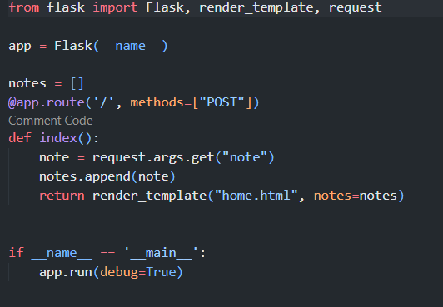
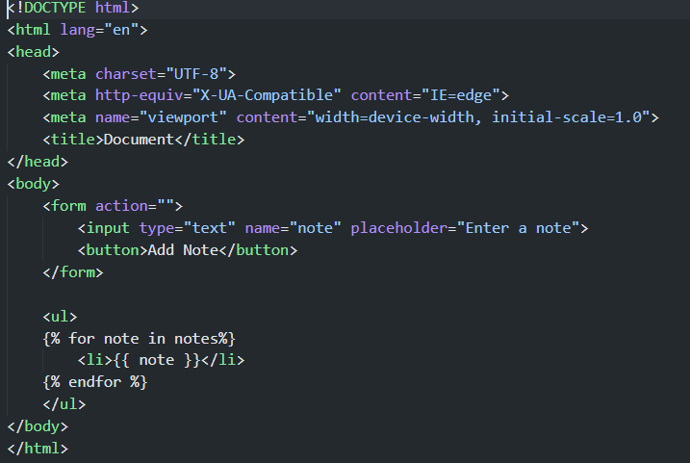
Initial Codebase:

Slide 5
Issue Identification
The issue arises because the form in the HTML template submits data using the POST method (method="POST"), but it sends the data as form data, not as query parameters. Therefore, accessing the note using request.args.get("note") results in None.
Approach to Resolve
After debugging, the approach to resolve the bug involves modifying the Flask route to handle both GET and POST requests and updating the logic to retrieve the note from the form data for POST requests.

Slide 6
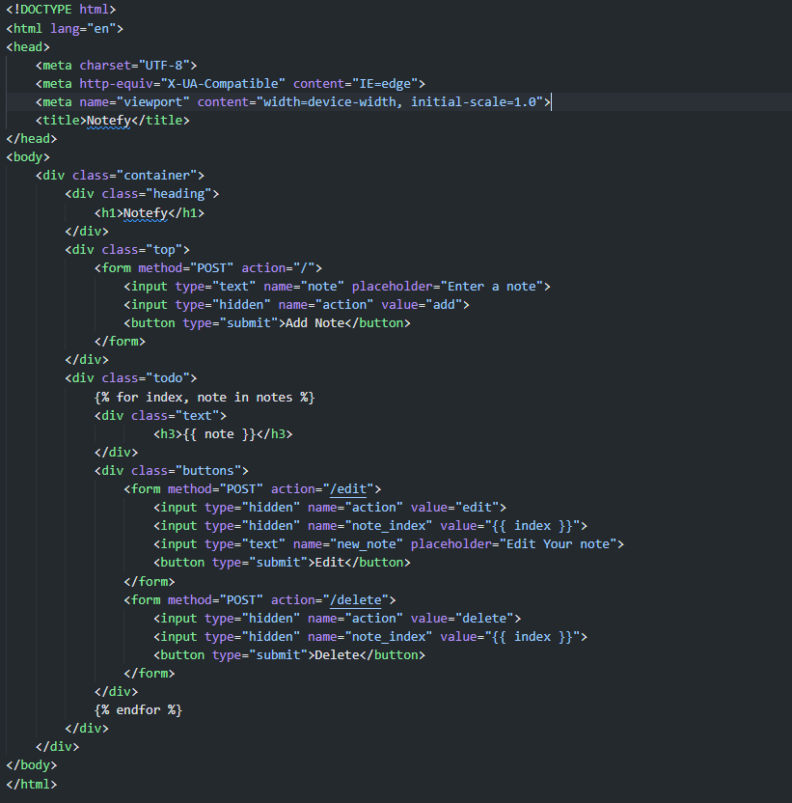
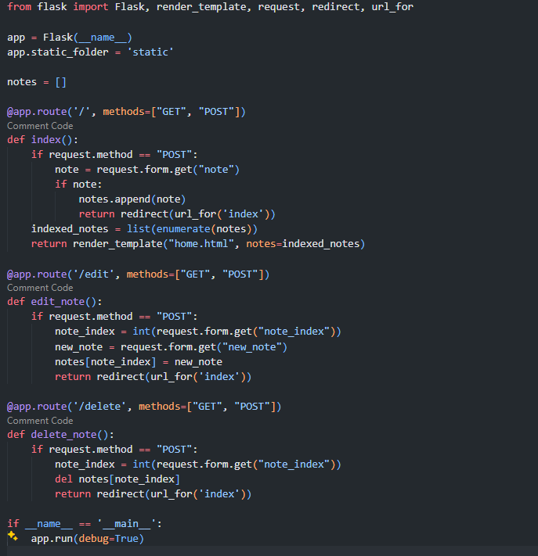
Corrected version

Slide 7
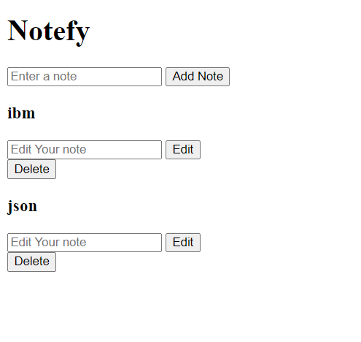
Final Output

Slide 8

THANK YOU

